Slide 1

Oeson Project 2: data visualization on hr dataset OGTIP Data Science Batch 2023
IBRAHIM OGUNTOLA

Slide 2
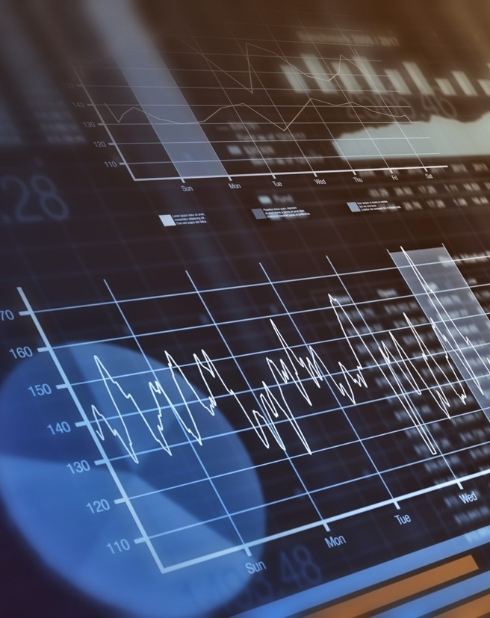
AGENDA
INTRODUCTION.
DESCRIPTIVE STATISTICS.
- Statistics & General Distribution.
DATA ANALYSIS AND VISUALIZATION.
- Demographic Analyses.
- Performance-based Analyses.
- Salary-based Analyses.
- Other Analyses.
CONCLUSION.

Slide 3

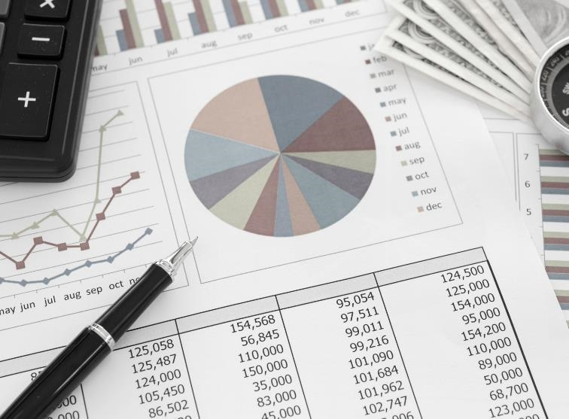
INTRODUCTION
In this project, a limited HR dataset from a reputed organization XYZ technologies is given which includes relevant information of the employees like Designation, Performance score, Salary etc.
​
This presentation will showcase visual charts created with Seaborn and Matplotlib. These visuals will help us draw insights and answer important questions about the dataset.

Slide 4

DESCRIPTIVE ANALYSES
-STATISTICS & GENERAL DISTRIBUTION

Slide 5
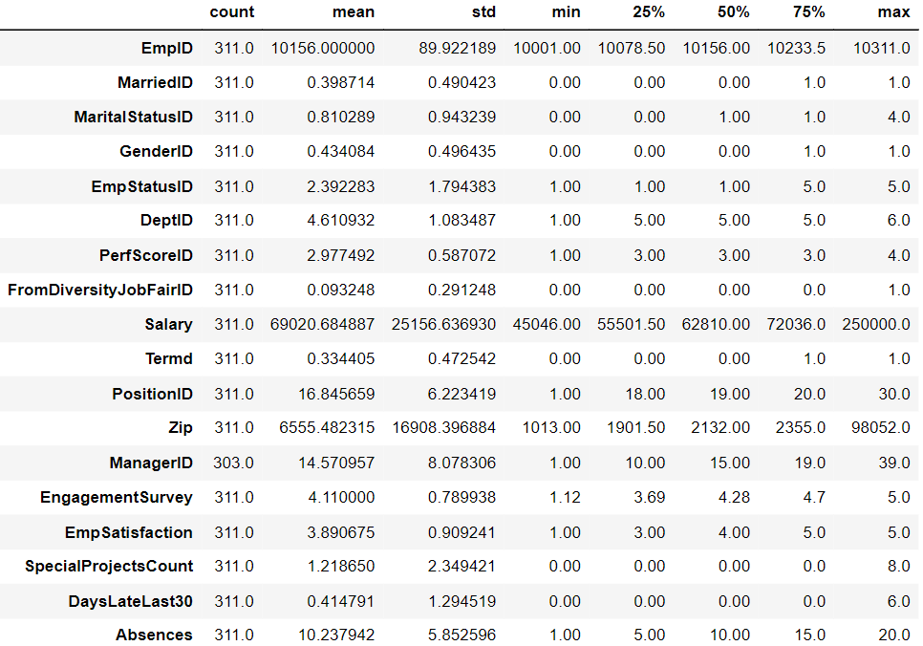
Descriptive Statistics About Relevant Fields

Slide 6
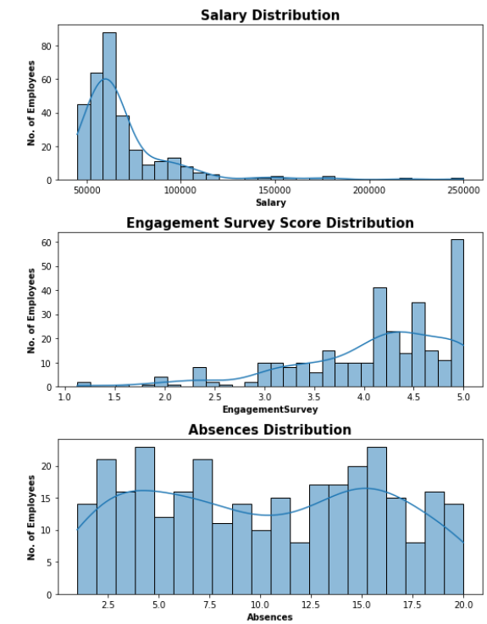
GENERAL DISTRIBUTION
Question 1: What are the distribution of some of the important columns?
Salary Distribution: This histogram with a fitted line shows the distribution of salaries. It appears that the majority of salaries are clustered around the lower to mid-range with a few outliers on the higher end. This suggests a right-skewed distribution where most employees earn less than the average salary.
Engagement Survey Score Distribution: This histogram depicts how engaged employees feel based on a survey score. There's a notable concentration of high engagement scores (around 4.0 and 5.0), indicating that a significant number of employees are highly engaged.
Absences Distribution: This histogram shows a relatively uniform distribution of absences, with a slight increase around 5 and a peak at 15. This may indicate that most employees have a few absences, with some having many more. The range of absences is wide, from 1 to 20 days, indicating diverse attendance patterns among employees.

Slide 7
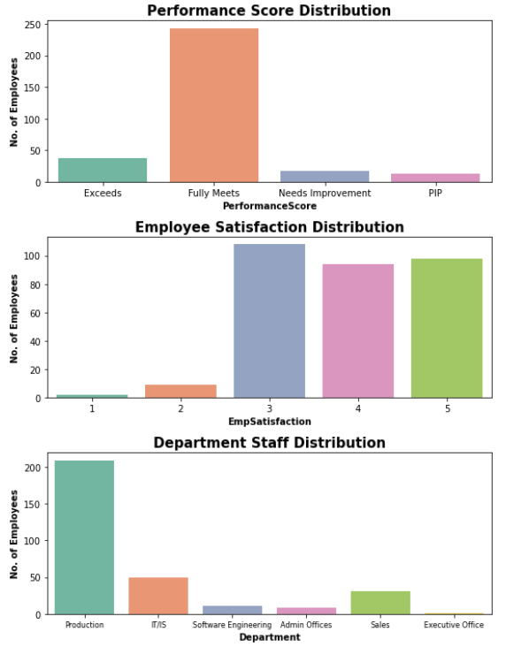
GENERAL DISTRIBUTION (cont.)
Performance Score Distribution: This bar chart shows the frequency of different performance scores. Most employees seem to "Fully Meet" performance expectations with fewer employees "Exceeding" or needing "Improvement". The least number of employees are undergoing a Performance Improvement Plan (PIP).
Employee Satisfaction Distribution: This bar chart indicates a generally positive level of employee satisfaction, with the majority of employees rating their satisfaction at levels 3, 4, and 5.
Department Staff Distribution: This bar chart shows the number of staff in various departments. The "Production" department has the most staff, followed by "IT/IS" and "Sales".

Slide 8
DATA ANALYSES AND VISUALIZATION
-DEMOGRAPHIC ANALYSES

Slide 9
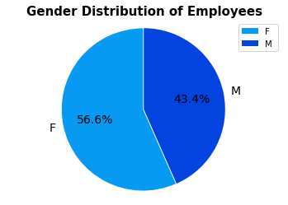
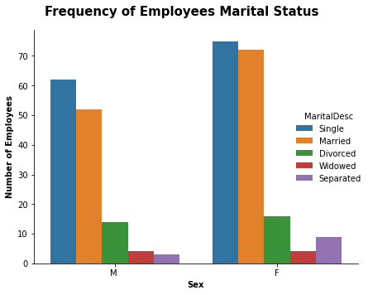
DEMOGRAPHIC ANALYSES
Question 2: What is the demographic distribution of the employees?
Gender Distribution of Employees
Frequency of Employees Marital Status
Answer: There are ~57% Females and ~43% Males. The largest demographic is that of single females and the smallest is that of separated males.

Slide 10
DATA ANALYSES AND VISUALIZATION
-PERFORMANCE-BASED ANALYSES

Slide 11
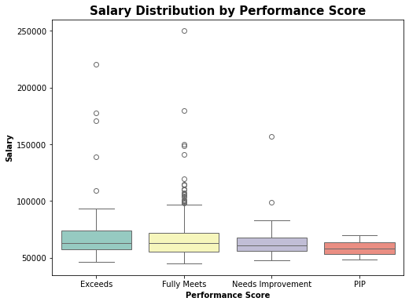
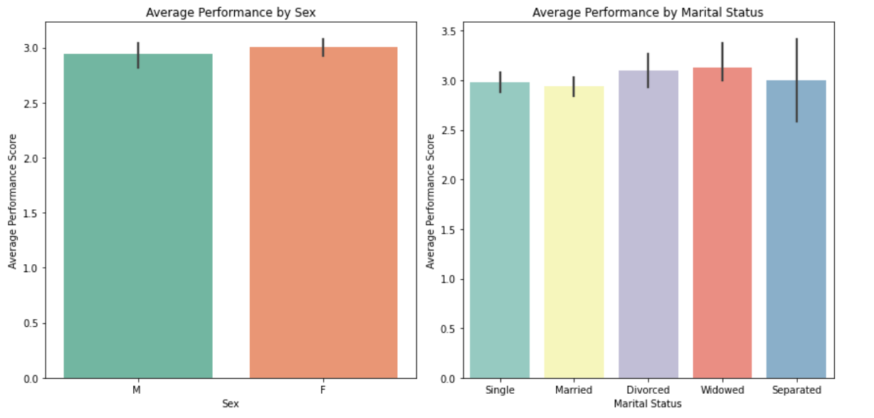
Performance Analyses- What leads to better performance?
Question 3: Does a higher salary correlate with better performance scores?
Question 4: How does sex and marital status influence performance?
Salary Distribution By Performance Score
Average Performance By Sex and Marital Status
Answer: Higher performance scores are generally associated with higher salaries, highlighting performance as a key factor in salary decisions. It could also mean employees earning well are more motivated to perform better.
Answer: The average performance scores are relatively similar across different sexes and marital statuses, suggesting a minimal impact of these factors on performance.
The bar plots reveal very small differences in performance scores between sexes or across marital statuses, indicating these demographic factors don't notably influence performance.

Slide 12
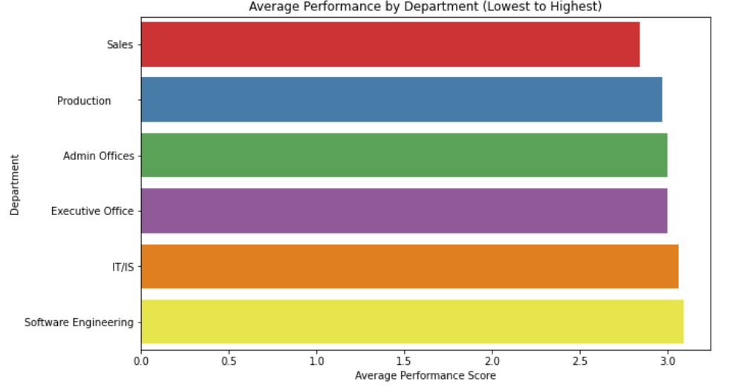
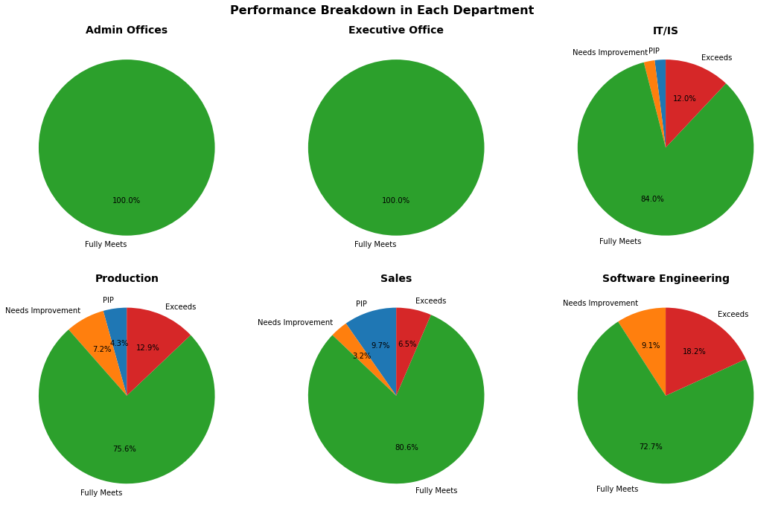
Performance Analyses- What leads to better performance?
Question 5: Which department has the best average performance?
Question 6: What does the distribution of performance scores across different departments indicate about employee performance?
Average Performance By Department
Performance Breakdown in Each Department
Answer: The bar plot shows notable variation in average performance scores across departments. Some departments, like ‘Software Engineering' and ‘IT/IS', trend towards higher scores, suggesting department-specific factors influencing performance.
Answer: The performance distribution highlights varied results; IT/IS and Software Engineering have a mix, including top performers and those on Performance Improvement Plans (PIPs), suggesting diverse performance levels. Contrastingly, departments like Admin Offices show uniformity with all employees meeting expectations.

Slide 13
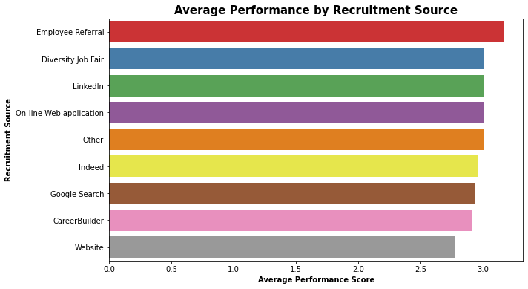
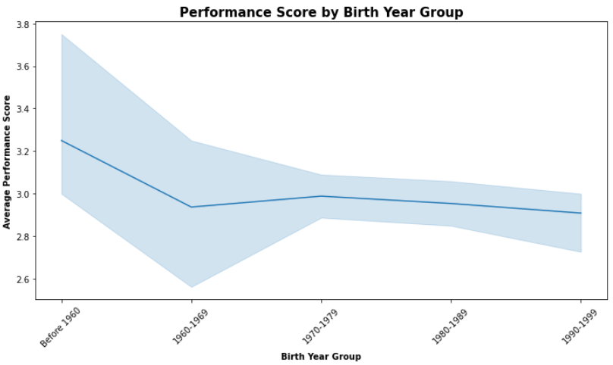
Performance Analyses- What leads to better performance?
Question 7: Which of the recruitment sources is efficient in employee high-performing employees?
Question 8: How do performance scores vary among employees from different birth year groups?
Average Performance By Recruitment Source
Performance Score By Birth Year Group
Answer: The bar plot indicates differences in average performance based on recruitment sources. Those employed through 'Employee Referral‘ seem to have higher performance scores than the rest, suggesting its effectiveness in attracting high-performing candidates.
Answer: The graph shows a consistent performance across all birth year groups, with a slight edge for employees born before 1960.

Slide 14
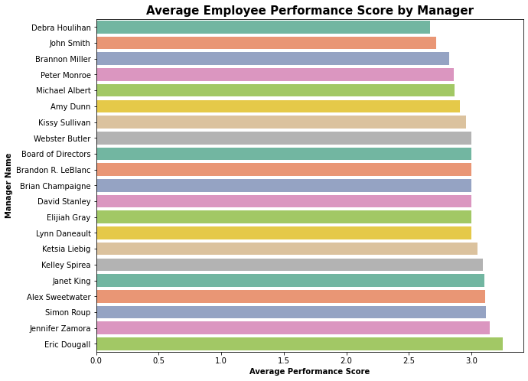
Performance Analyses- What leads to better performance?
Question 9: Which managers have the best performing subordinates?
Average Employee Performance Score By Manager
Answer: The bar chart shows average employee performance scores by manager. Eric Dougall's team leads in performance, while Debra Houlihan's team has the lowest score. The company could use strategies from higher-performing teams to help improve others.

Slide 15
DATA ANALYSES AND VISUALIZATION
-SALARY-BASED ANALYSES

Slide 16
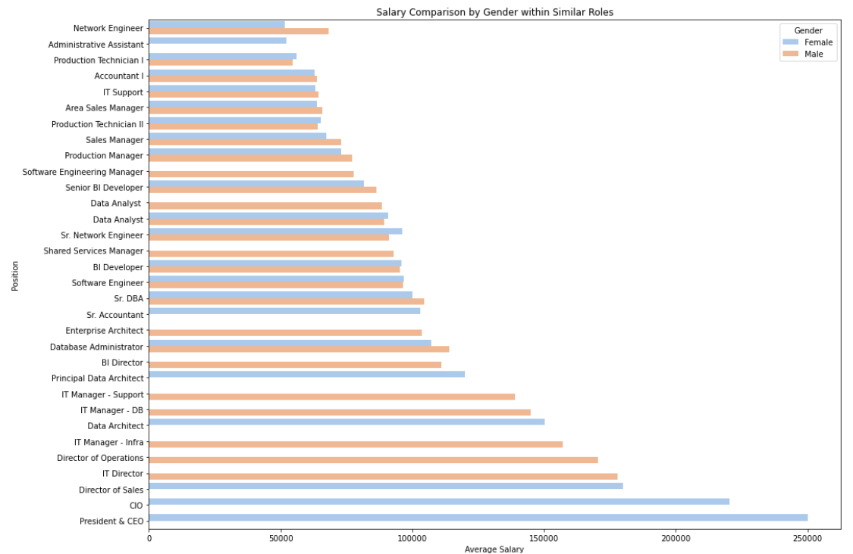
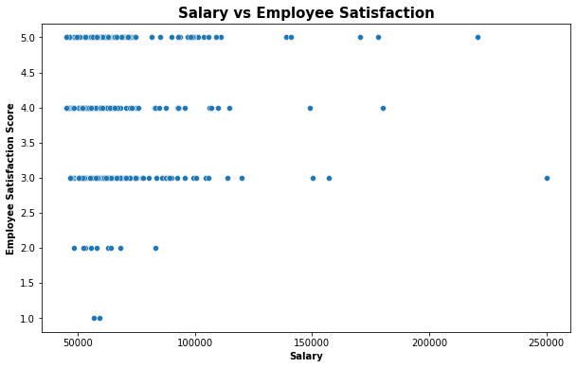
Salary Analyses- What leads to a better salary?
Question 10: In similar roles, how does the average salary compare between genders?
Question 11: Does a higher salary correlate with increased job satisfaction among employees?
Salary Comparison By Gender Within Similar Roles
Salary VS Employee Satisfaction
Answer: The visualization reveals that salary disparities between genders exist in several roles, with some positions showing a pronounced gap. This insight may indicate areas where gender pay equity could be addressed.
Answer: The data suggests that employees earning around $100k and above generally experience above-average job satisfaction, while those with lower salaries show a broader range of satisfaction levels.

Slide 17
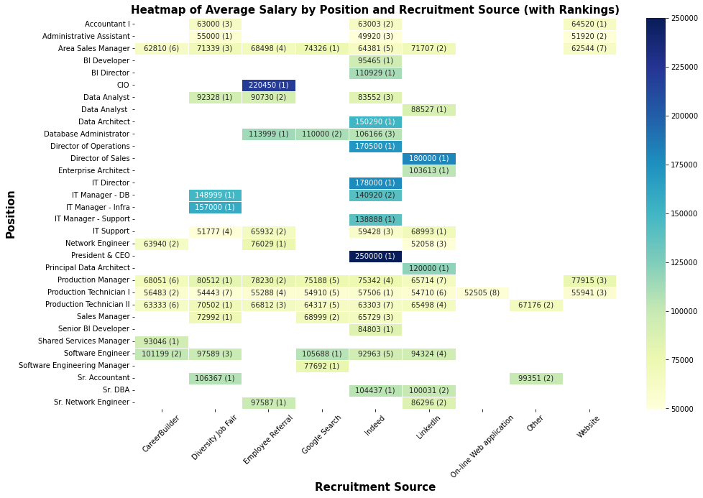
Salary Analyses- What leads to a better salary?
Question 12: How does the recruitment source influence salary levels for different positions?
Heatmap of Average Salary By Position And Recruitment Source (with rankings)
Answer: Job seekers should note that candidates from the Diversity Job Fair tend to secure higher-paying roles across various positions. Strategic application through proven sources can influence starting salaries.

Slide 18
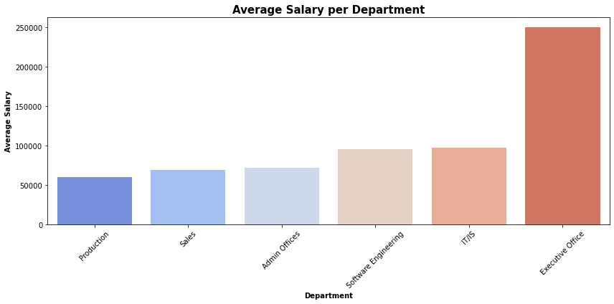
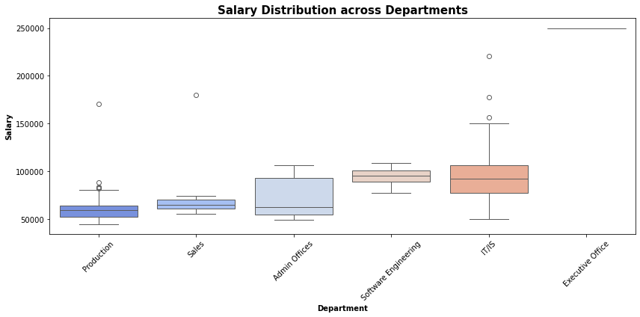
Salary Analyses- What leads to a better salary?
Question 13: Which departments generally have the highest salary?
Average Salary Per Department
Salary Distribution Across Departments
Answer: Certain departments exhibit higher salary ranges, indicative of specialized skill requirements or seniority e.g, Executive Office roles get the highest pay. This suggests job seekers should consider departmental pay scales when assessing potential employment opportunities.

Slide 19
DATA ANALYSES AND VISUALIZATION
-OTHER ANALYSES

Slide 20
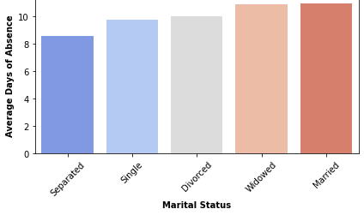
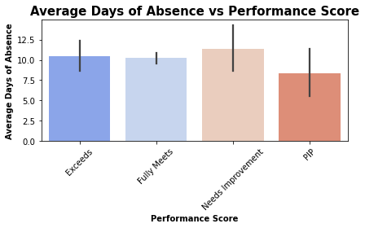
Other Analyses
Question 14: How does marital status correlate with average days of absence in the workplace?
Question 15: How does the average number of days of absence relate to employee performance scores?
Absences VS Marital Status
Average Days of Absence VS Performance Score
Answer: The bar chart suggests a trend where married employees have the highest average days of absence, with a gradual decrease observed in widowed, divorced, single employees, and the lowest absences among separated employees. This pattern may reflect the varying levels of personal commitments or stability associated with each marital status.
Answer: The chart shows that employees who exceed expectations have slightly more absences than those who fully meet them, but absences rise significantly for those needing improvement and decrease again for those on Performance Improvement Plans probably due to more managerial scrutiny.

Slide 21
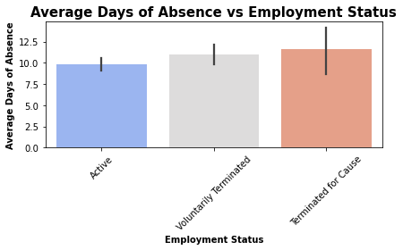
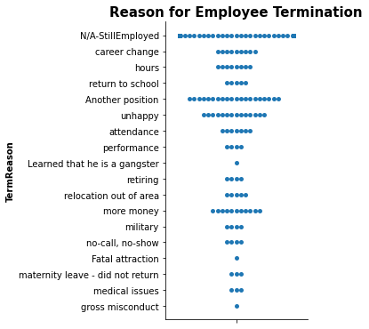
Other Analyses
Question 16: How does the average absence duration differ between employees' job status
Question 17: What are the main reasons for employee departure from the organization?
Average Days of Absence VS Employment Status
Average Days of Absence VS Performance Score
Answer: The chart indicates that employees terminated for cause had the highest average absences, suggesting absenteeism may be a factor in such terminations. Active employees show fewer absences, and those who left voluntarily had a moderate average, highlighting different absence patterns across employment statuses.
Answer: The swarm plot indicates that career change, position change and happiness are frequent reasons for employee terminations, with occasional cases related to factors like 'attendance' and 'performance'. Unique reasons like 'Learned that he is a gangster' also appear, though they are less common. Management could use these insights to address workplace issues and improve retention.

Slide 22

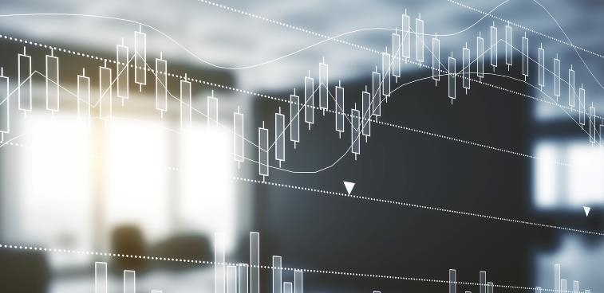

CONCLUSION
- In our analysis of XYZ Technologies' HR dataset, we discovered key insights into performance, salary, and employee demographics.
- Key findings include a strong correlation between performance and salary, and minimal demographic impact on performance, highlighting the effectiveness of current HR practices.
- Variations in departmental performance suggest potential areas for improvement. The analysis also underscores the importance of continually assessing and refining compensation policies to ensure fairness and effectiveness in talent acquisition.
- Moving forward, XYZ Technologies could benefit from focusing on equitable compensation and leveraging successful departmental practices across the organization to enhance overall performance and employee satisfaction.

Slide 23

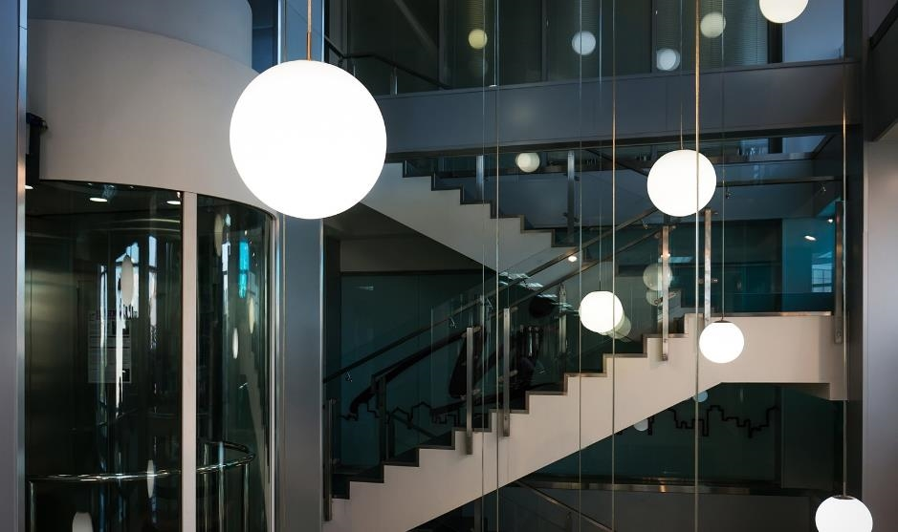
THANK YOU

